Slide 1

Data Analysis Essentials
Cornerstone Project — Second Review
Food Delivery Data Analysis
K.jaswanthi 25B11AI619
J.deekshitha 25B11AI418
k.Pravallika 26b21ai052
Ch. siri Varshini 26B21AI017
Department
Department of Artificial Intelligence & Machine Learning

Slide 2

SECOND REVIEW
This example emphasizes completed work and evidence, not project planning.
1. Implementation
Working notebook/code, successful execution, model or analysis output
2. Preprocessing
Actual missing-value treatment, duplicates, transformations and final dataset
3. Analysis
EDA, comparisons, statistics and patterns discovered from the data
4. Visualization
Graphs + interpretation of what each graph tells us
5. Results
Metrics, key findings, conclusions and recommendations
6. Presentation
Report/notebook evidence and clear individual contribution

Slide 3
PROJECT OVERVIEW — FOOD DELIVERY DATA ANALYSIS
Problem
Identify factors that influence food delivery orders, customer ratings, delivery time and order value.
Objective
Clean the food-delivery dataset, perform EDA, visualize important patterns and generate useful service insights.
Dataset
50,000 raw records with 1,000 duplicate rows. After duplicate removal: 49,000 unique records. No null values are present in the generated dataset.
Tools
Python • Pandas • NumPy • Matplotlib • Google Colab

Slide 4
DATASET SNAPSHOT — BEFORE & AFTER CLEANING
Before cleaning
Rows: 50,000
Columns: 11
Duplicate rows: 1,000
Missing values: 0
After cleaning
Rows: 49,000
Columns: 11
Duplicate rows: 0
Missing values: 0
Dataset fields
Order ID, customer age, city, cuisine, restaurant, order value, distance, delivery time, customer rating, payment method and order status.

Slide 5
IMPLEMENTATION — DATA PREPROCESSING
Step 1 — Load dataset
Read the 50,000 food-delivery records using Pandas.
Step 2 — Duplicate removal
Detected and removed 1,000 duplicate order rows.
Step 3 — Missing-value check
Checked every column; the final dataset contains 0 null values.
Step 4 — Final validation
Verified row count, duplicate count, data types and basic statistics.
Result
Clean dataset with 49,000 unique records is ready for EDA and visualization.

Slide 6
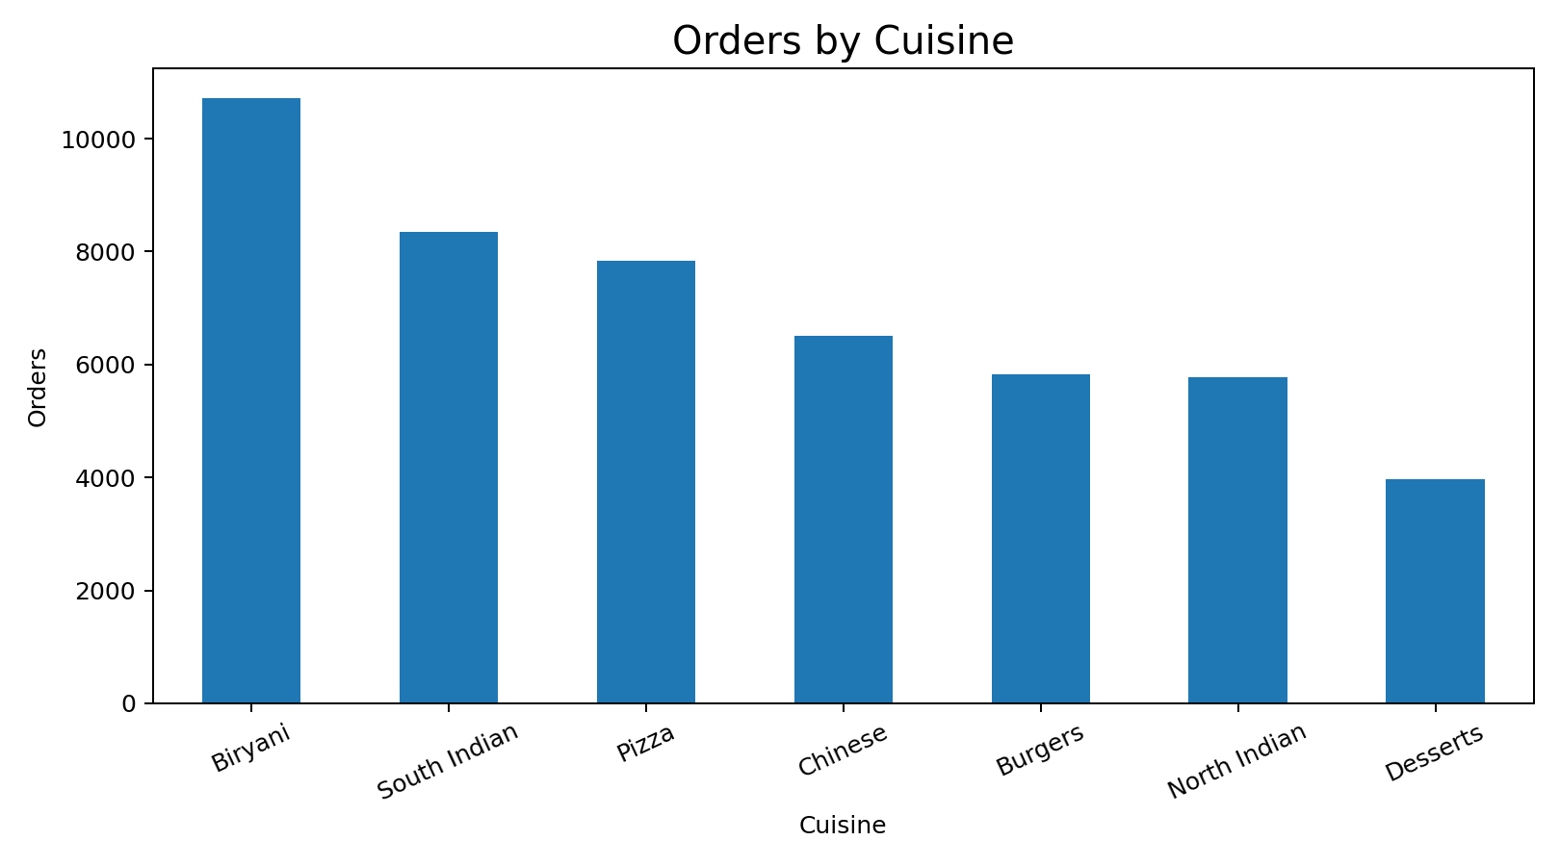
DATA ANALYSIS — ORDERS BY CUISINE
Key observation
Biryani has the highest number of orders in the dataset (10,714). This helps identify popular food categories.

Slide 7
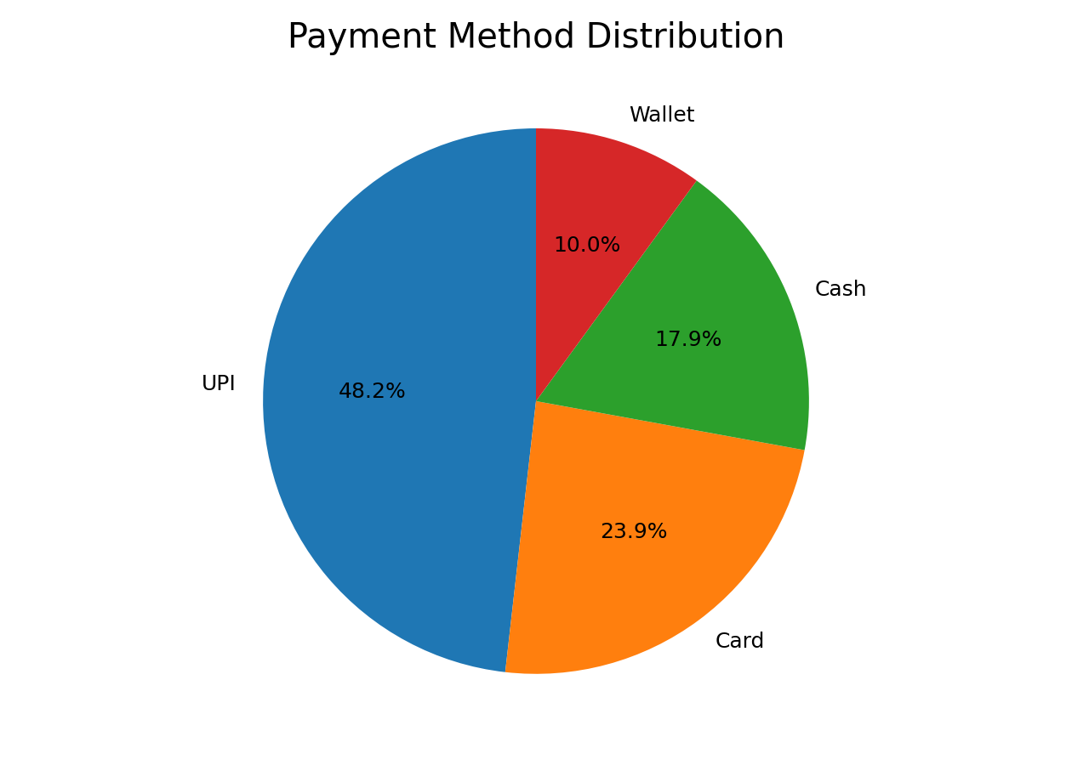
DATA ANALYSIS — PAYMENT METHODS
Key observation
UPI is the most-used payment method (23,619 orders). This can guide payment integration and customer convenience.

Slide 8
PROJECT IMPLEMENTATION — PYTHON CODE
import pandas as pd
import matplotlib.pyplot as plt
df = pd.read_csv("food_delivery_dataset_50000.csv")
df = df.drop_duplicates()
print(df.shape)
print(df.isnull().sum().sum())
df["Cuisine"].value_counts().plot(kind="bar")
plt.title("Orders by Cuisine")
plt.show()
df["Payment_Method"].value_counts().plot(
kind="pie", autopct="%1.1f%%"
)
plt.title("Payment Method Distribution")
plt.ylabel("")
plt.show()

Slide 9
VISUALIZATION & INTERPRETATION
1. Cuisine Bar Chart
Compares the number of orders across food categories.
2. Payment Pie Chart
Shows the proportion of orders made through UPI, cash, card and wallet.
3. City Bar Chart
Compares food-order demand across cities.
4. Order Status Chart
Shows delivered, cancelled and pending orders.
Why this matters
Graphs make food-order patterns easier to compare and help convert raw data into business insights.

Slide 10
RESULTS & KEY FOOD-DELIVERY INSIGHTS
Dataset result
50,000 raw records → 49,000 unique records after removing 1,000 duplicates.
Finding 1
Most popular cuisine: Biryani (10,714 orders).
Finding 2
Most-used payment method: UPI (23,619 orders).
Finding 3
Highest-order city: Warangal (8,309 orders).
Finding 4
Delivered orders form the largest order-status group (42,290 orders).
Conclusion
Cuisine preference, payment choice, location and order status are useful variables for understanding food-delivery performance.

Slide 11
PROJECT REPORT & PRESENTATION EVIDENCE
Report contents
Problem statement • Dataset description • Preprocessing • EDA • Visualizations • Results • Insights • Conclusion
Notebook / Code
Working Python code with dataset loading, duplicate removal, null checking, statistics and graphs.
Presentation
Charts are labelled and each major visualization includes an interpretation.
Evidence for viva
Show the CSV dataset, preprocessing output, graphs, summary statistics and key findings.
Individual contribution
Each student should explain the part they implemented and justify the analysis choices.

Slide 12
COMPLETED FOOD DELIVERY PROJECT WORKFLOW
Raw Food Delivery Dataset
↓
Data Inspection
↓
Duplicate Removal + Null Check
↓
Preprocessing
↓
Exploratory Data Analysis (EDA)
↓
Visualization
↓
Food-Order Comparisons
↓
Insights
↓
Final Report
Every stage has evidence through code, output, chart, statistic or interpretation.

Slide 13
CONCLUSION — SECOND REVIEW
The Food Delivery Data Analysis project demonstrates a complete data-analysis pipeline.
The raw dataset was inspected, cleaned and validated.
EDA and visualizations were used to identify patterns in cuisine preferences, payment methods, city demand and order status.
The analysis converts food-delivery records into practical insights that can help understand customer and service behaviour.
The final review focuses on implementation evidence, results, interpretation and individual contribution.

Slide 14
THANK YOU

